Slide 1
PwC Azure DevOps Workshop
April 16-17, 2019
Stephen T. Mann
Cloud Solution Architect
stephen.mann@microsoft.com

Slide 2
Agenda
Day 1:
Azure DevOps: Introduction (How Microsoft does DevOps)
Azure Boards: Agile Project Management
Lunch
Azure Repos: Introduction
Azure Pipelines: Continuous Integration
Day 2:
Azure Pipelines: Continuous Delivery
Azure Repos: Branching & Policies
Lunch
Azure Test Labs: Automate Testing
Azure Pipelines: Continuous Delivery Part 2

Slide 3
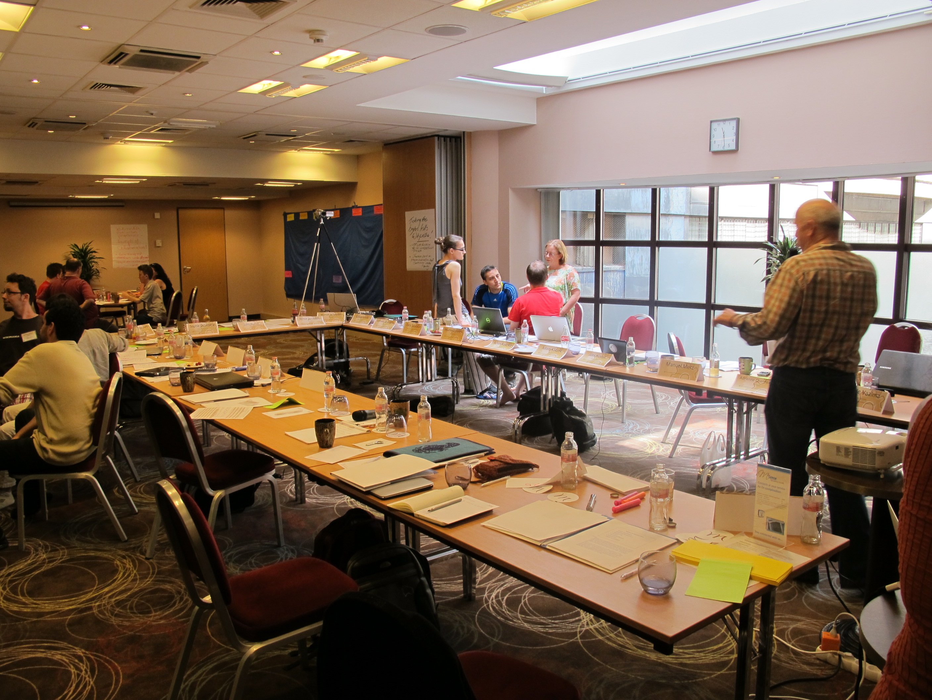
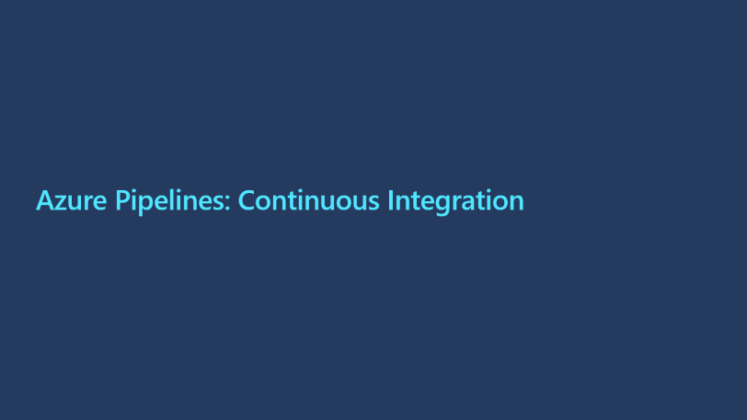
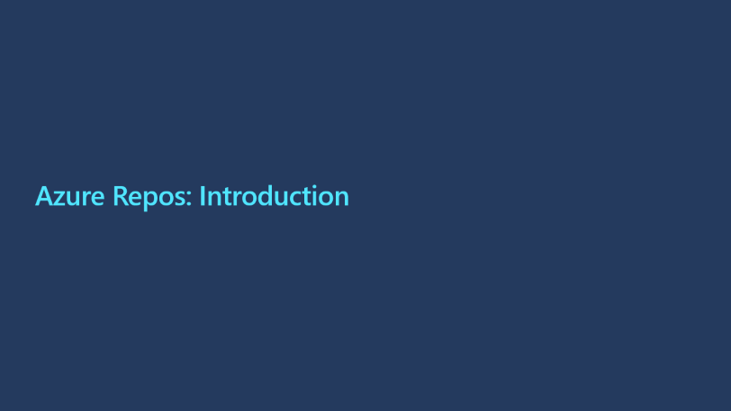
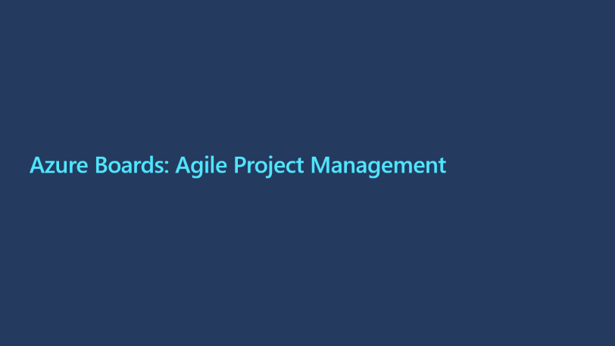
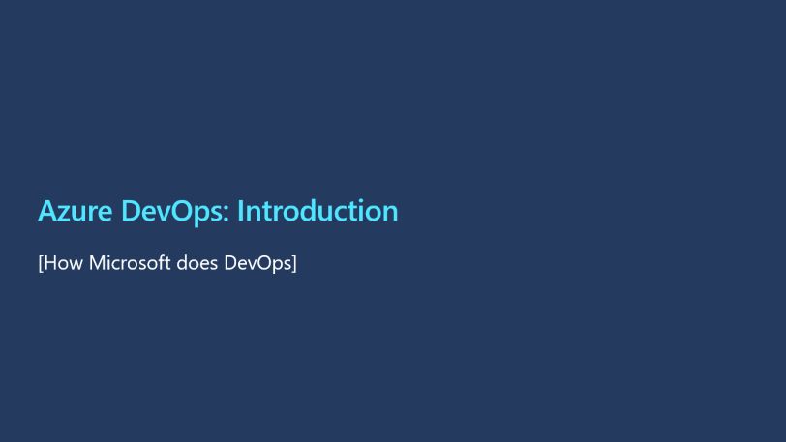
Day 1

Slide 4
Azure DevOps: Introduction
[How Microsoft does DevOps]

Slide 5
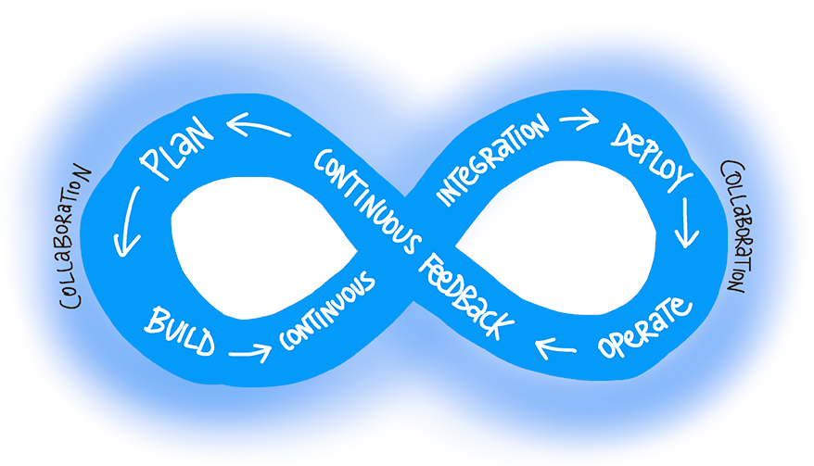
What is “DevOps”?
“DevOps is the union of people, process, and products to enable continuous delivery of value to our end users.” - Sam Guckenheimer
Joining Development and Operations
Multidisciplinary teams that now work together with shared and efficient practices and tools.
Essential DevOps practices
Agile planning
Continuous integration
Continuous delivery
Monitoring of applications
DevOps Learning Resources:
https://aka.ms/devops

Slide 6

How Microsoft does DevOps.
Moving to cloud cadence
Agile principals in practice
Branching
“One Engineering System” - (“1ES”)
Trunk based branching https://trunkbaseddevelopment.com/
DevSecOps
red teams and blue teams
Live-Site Culture (or a Production-First Mindset)
Testing
Martin Woodward
Principle Program Manger

Slide 7

Azure DevOps (the product formerly known as VSTS)
Azure DevOps Services is the cloud offering that provides a scalable, reliable, and globally available hosted service. It's backed by a 99.9% SLA, monitored by our 24/7 operations team, and available in local data centers around the world.
Azure DevOps Server is the on-premises offering that's built on a SQL Server back end. Companies usually choose on-premises when they need their data to stay within their network or when they want access to SQL Server reporting services that integrate with Azure DevOps data and tools.
Although both offerings provide the same essential services, compared with Azure DevOps Server, Azure DevOps Services offers the following added benefits:
Simplified server management.
Immediate access to the latest and greatest features
Improved connectivity with remote sites.
A transition from capital expenditures (servers and the like) to operational expenditures (subscriptions).

Slide 8
Azure Boards: Agile Project Management

Slide 9
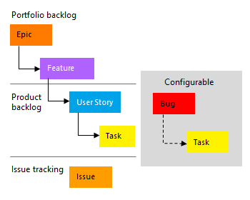
Azure Boards: Agile Project Management
What is Agile Boards?
With Azure Boards, you can quickly and easily start tracking user stories, backlog items, task, features, and bugs associated with your project. You do this by adding one of these work item types—user stories, bugs, features, epics, and tasks—that the Agile process provides. As works progresses from not started to completed, you update the State workflow field from New, Active, Resolved, and Closed.

Slide 10
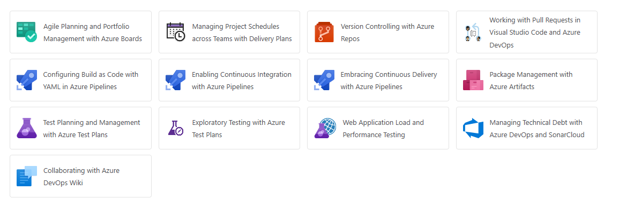
Exercise 1
Go to Agile Planning and Portfolio Management with Agile Boards
https://www.azuredevopslabs.com/labs/azuredevops/agile
Complete Exercise 1, Tasks 1-5 only.

Slide 11
Azure Repos: Introduction

Slide 12
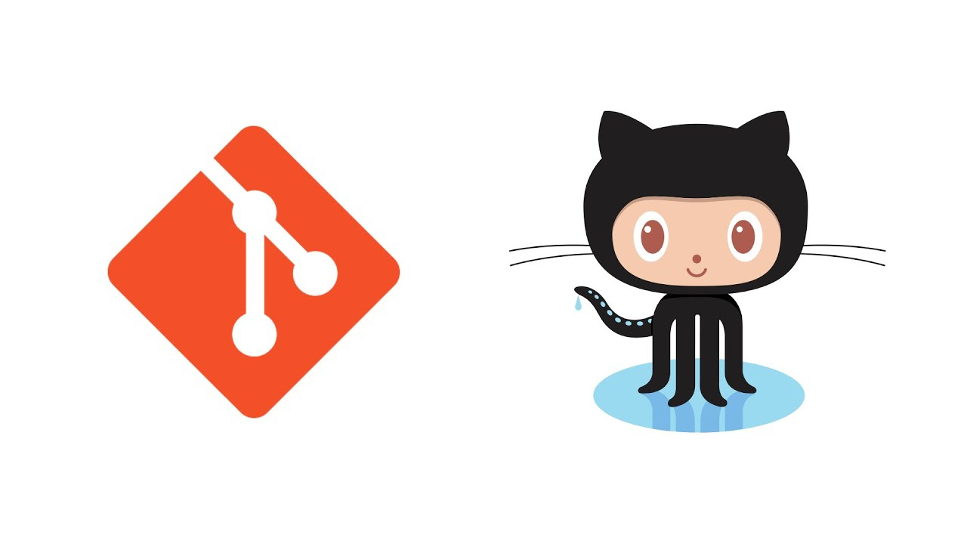
Azure Repos: Introduction
Historically version control has been the first component that teams have implemented, it is one of the oldest and most well understood components of DevOps.
Git is the most commonly used version control system today and is quickly becoming the standard for version control.

Slide 13
Azure Repos: Code Management
Branch
The first step when a developer wants to fix a bug or implement a feature is to create a new branch off of our main integration branch, master. Thanks to Git's lightweight branching model, we create these short-lived "topic" branches any and every time we want to write some code. Developers are encouraged to commit early and to avoid long-running feature branches by using feature flags.
Push
When the developer is ready to get their changes integrated and ship their changes to the rest of the team, they push their local branch to a branch on the server and open a pull request. Since we have several hundred developers working in our repository, each with many branches, we use a naming convention for branches on the server to help alleviate confusion and what we call "branch proliferation". Generally developers create a local branch named users/<username>/feature, where <username> is (of course) replaced with their account name. For example, I create branches inside the users/stman folder.

Slide 14
Azure Repos: Code Management (continued)
Pull Request
We use Azure DevOps Pull Requests to control how developer's topic branches are merged into master. Pull Requests ensure that our branch policies are satisfied: first, we build the proposed changes and run a quick test pass. We run about 60,000 tests — our "level 0" and "level 1" test suites — in just under five minutes. This isn't our complete test matrix, but it's enough to quickly give us a high confidence in pull request.
Next, we require that other members of the Azure DevOps team review the code and approve the changes. Code review picks up where the automated tests left off and are particularly good at spotting architectural problems. Manual code reviews ensure that more engineers on the team have visibility into the changes and that code quality remains high.
Merge
Once all the build policies are satisfied and reviewers have signed off, then the pull request is completed. This means that the topic branch is merged into the main integration branch, master.
After merge, we run additional acceptance tests that take more time to run. These are more like a traditional post-check-in tests and we use them to perform an even more thorough validation. This gives us a good balance between having fast tests during the pull request review yet still having complete test coverage before release.

Slide 15
Exercise 2
Go to Version Controlling with Azure Repos
https://www.azuredevopslabs.com/labs/azuredevops/git
Complete Exercises 6 and 7 only.

Slide 16
Azure Pipelines: Continuous Integration

Slide 17
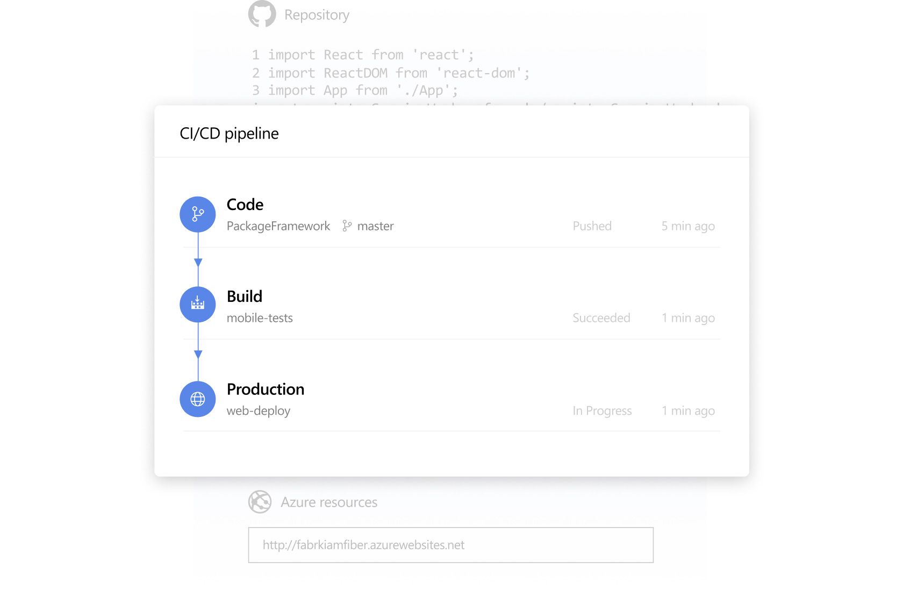
Continuous Integration
Continuous Integration (CI) is the process of automating the build and testing of code every time a team member commits changes to version control.
Teams use build definitions to ensure that every commit to the master branch triggers the automated build and testing processes. Implementing CI this way ensures bugs are caught earlier in the development cycle, which makes them less expensive to fix. Automated tests run for every build to ensure builds maintain a consistent quality.

Slide 18
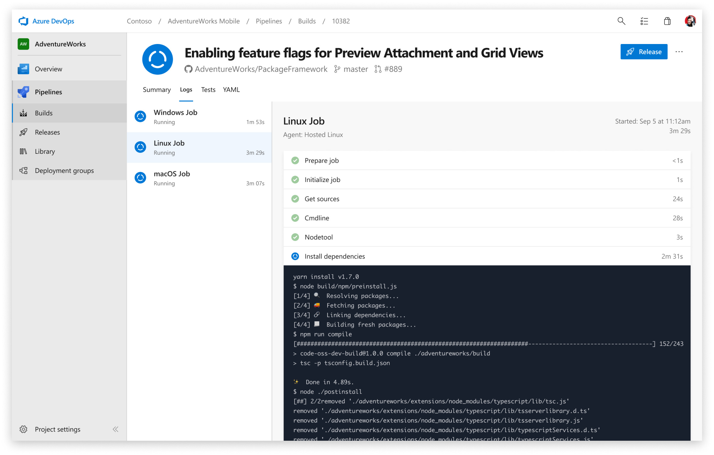
Azure Pipelines: Build Pipeline
Defining a Build Pipeline
YAML vs Classic
Enabling CI
YAML CI Configuration

Slide 19
Exercise 3
Go to Enabling Continuous Integration with Azure Pipelines
https://www.azuredevopslabs.com/labs/azuredevops/continuousintegration
Complete Exercise 1.

Slide 20
End of Day 1

Slide 21
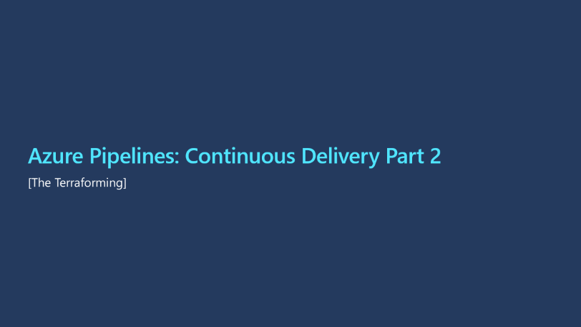
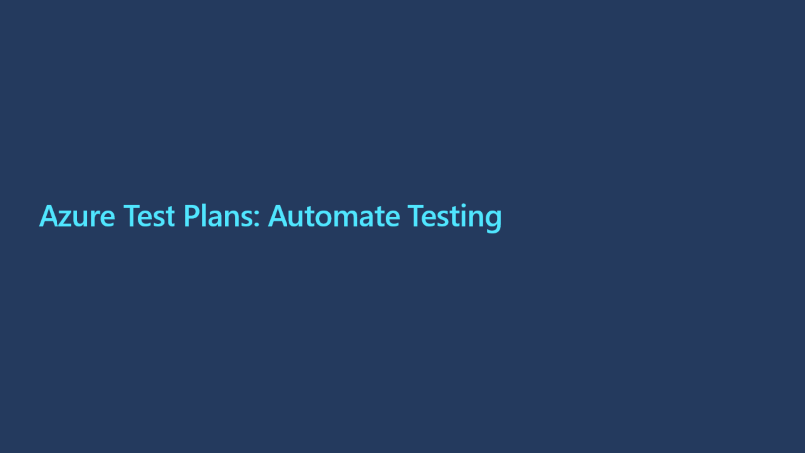
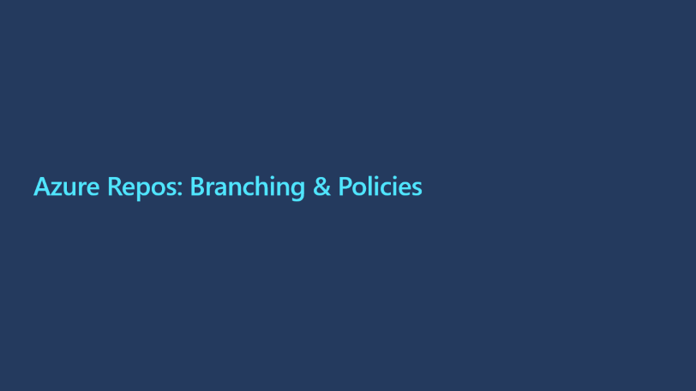

Day 2

Slide 22
Azure Pipelines: Continuous Delivery
Notes:
Show of hands, how many of you have used an Azure release pipeline?
Of those, how many of you believe that you need a separate pipeline for each distinct environment?

Slide 23
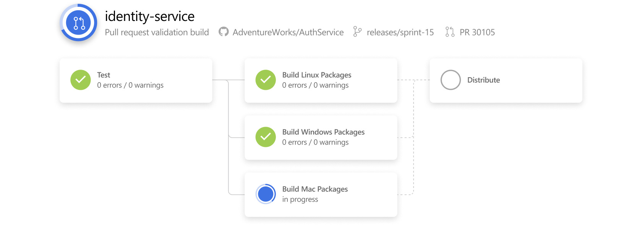
Azure Pipelines: Continuous Delivery
Continuous Delivery (CD) is the process to build, test, configure and deploy from a build to a production environment. Multiple testing or staging environments create a Release Pipeline to automate the creation of infrastructure and deployment of a new. Successive environments support progressively longer-running activities of integration, load, and user acceptance testing.
Continuous Delivery may sequence multiple deployment “rings” for progressive exposure (also known as “controlling the blast radius”).
Continuous Delivery is a lean practice. The goal of CD is to keep production fresh by achieving the shortest path from the availability of new code in version control or new components in package management to deployment.

Slide 24
Exercise 4
Go to Embracing Continuous Delivery with Azure Pipelines
https://aka.ms/PartsUnlimitedArm
https://www.azuredevopslabs.com/labs/azuredevops/continuousdeployment
Notes:
After completing lab, cover gate controls.

Slide 25
Azure Repos: Branching & Policies

Slide 26
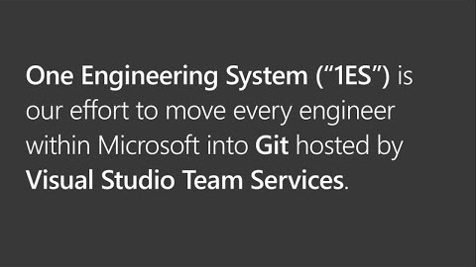
Azure Repos: Branching & Policies
Now that we have a deployed instance of our code, we are likely going to get a request to add a feature to our code. To this we need to implement a branching strategy.
We also want to protect our existing code from bugs as much as possible; so to ensure a minimum of standards are adhered to, we will enforce branch policies when a pull request is submitted.
Edward Thomson
Git Community program manager for Azure DevOps

Slide 27
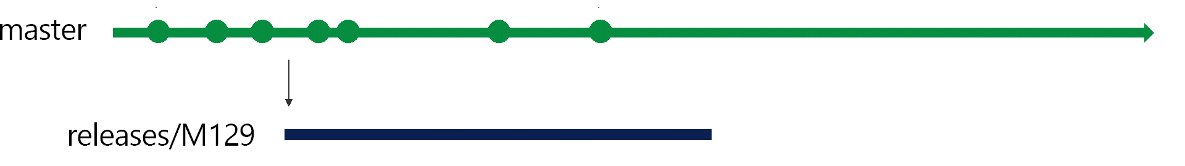
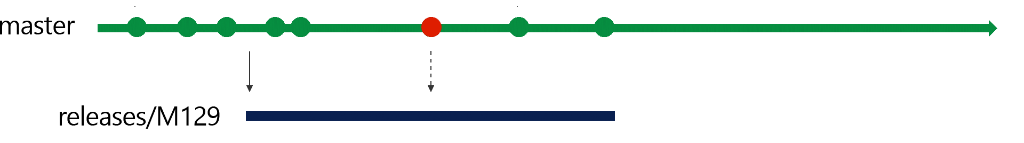
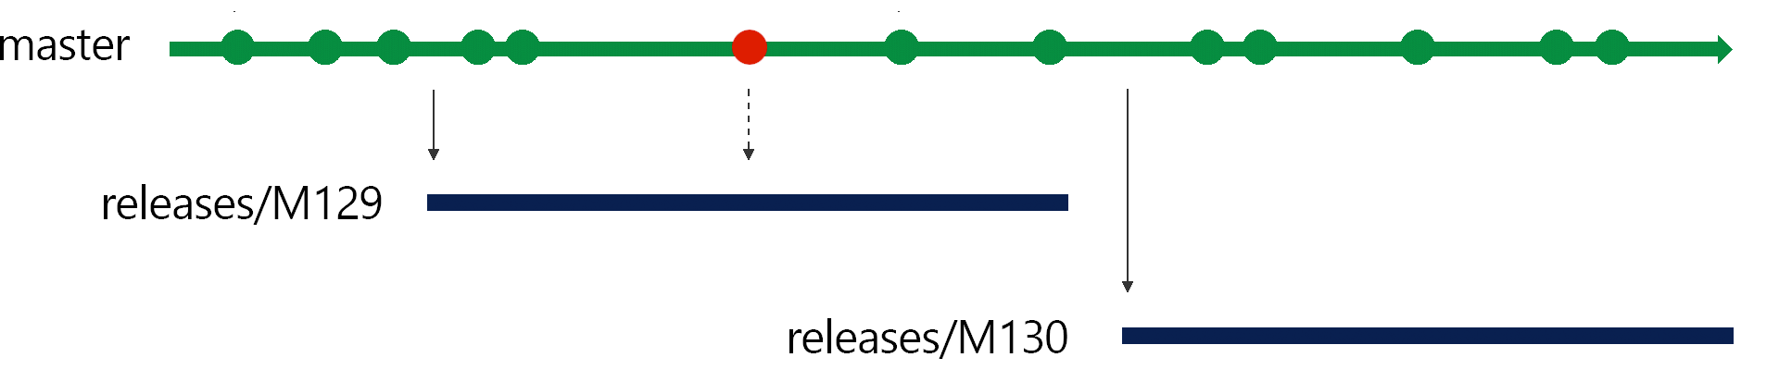
Azure Repos: Microsoft’s Branching Strategy
Release Flow
We continue developing in our master branch and batch up deployments into three week blocks, aligned with our sprint cadence.
At the end of a sprint, we create a deployment branch from the master branch: for example, at the end of sprint 129, we create a new branch releases/M129. We then put the sprint 129 branch into production.
After three weeks, we'll finish adding features to sprint 130, and we'll be ready to deploy those changes. To deploy, we'll create the new release branch, releases/M130 from master, and deploy that.

Slide 28
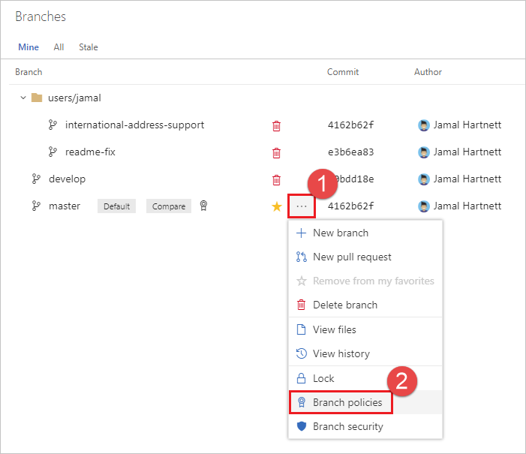
Azure Repos: Protecting Branch Integrity with Policies
Branch policies are an important part of the Git workflow and enable you to:
Isolate work in progress from the completed work in your master branch
Guarantee changes build before they get to master
Limit who can contribute to specific branches
Enforce who can create branches and the naming guidelines for the branches
Automatically include the right reviewers for every code change
Enforce best practices with required code reviewers

Slide 29
Azure Test Plans: Automate Testing

Slide 30
Code Quality in a CI/CD World
How did our approach to Quality changed in the Cloud cadence? We did three big things.
We redefined quality ownership, we fixed the accountability.
We understood that in order to ship frequently, Master branch must always remain as healthy as the release branch. We defined a core principle – Master is always shippable. The principle touches everything – source code management, code practices, build etc. From testing perspective, we pushed two things: shift-left testing (i.e. greater emphasis on unit testing) and eliminating flaky tests.
We also understood there is no place like production. This is the shift-right part of the strategy. it’s a set of practices about both safeguarding the production as well as ensuring quality in production.
In other words, we pushed testing left, we pushed testing right and got rid of most of the testing in the middle. This is a departure from the past where most of the testing that was happening in the middle – integration style testing in the lab.
Test Taxonomy
We needed new taxonomy. Previous taxonomy was based on duration of the tests, nightly run (NAR), full automation run (FAR), etc. We created new taxonomy that was based on the measure of external dependencies. We roughly divided tests into two categories.
L0/L1 – Unit tests
L0 – Broad class of fast in-memory unit tests. An L0 test is a unit test to most people. That is a test that depends on code in the assembly under test and nothing else.
L1 – A L1 test might require the assembly plus SQL or the file system.
L2/L3 – Functional tests
L2 – Functional tests run against “testable” service deployment. It is a functional test category that requires a service deployment but may have key service dependencies stubbed out in some way.
L3 – This is a restricted class of integration tests that run against production. They require a full product deployment.

Slide 31
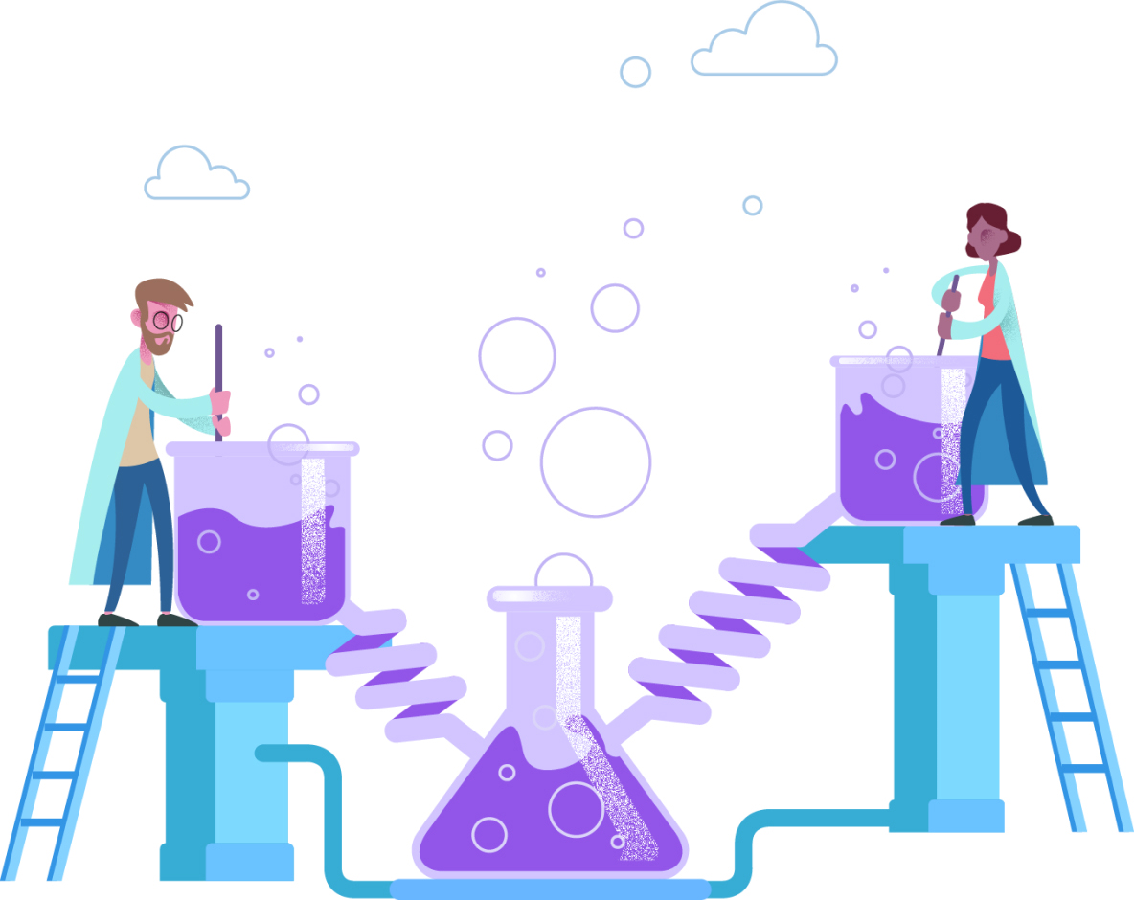
Azure Test Plans: Automate Testing
Test Planning and Management
Exploratory Testing
Load and Performance Testing

Slide 32
Exercise 5
Go to Test Planning and Management with Azure Test Plans
https://www.azuredevopslabs.com/labs/azuredevops/testmanagement
Complete exercise 2.

Slide 33
Azure Pipelines: Continuous Delivery Part 2
[The Terraforming]

Slide 34
Azure Pipelines: Continuous Delivery Part 2
Previously we delivered our product by creating a release pipeline that used Azure Resource Manager (ARM). We can also use Terraform to release our product to Azure.
Some notable take-aways when using Terraform:
By default, Terraform stores state locally in a file named terraform.tfstate. When working with Terraform in a team, use of a local file makes Terraform usage complicated. With remote state, Terraform writes the state data to a remote data store. We are going to use an Azure CLI task to create Azure storage account and storage container to store Terraform state.
The Terraform extension will need to be installed in the DevOps organization.

Slide 35
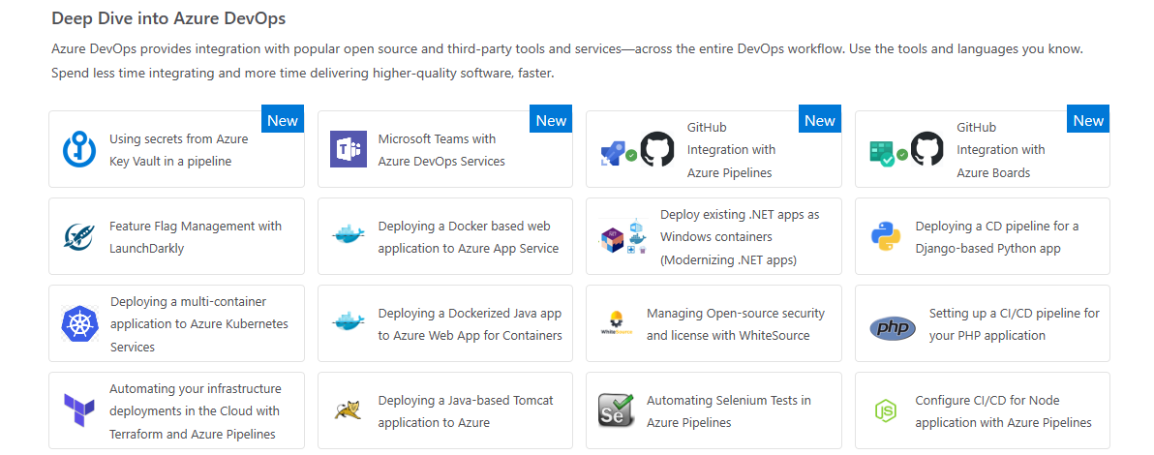
Exercise 6
Go to Automating your infrastructure deployments in the Cloud with Terraform and Azure Pipelines
https://www.azuredevopslabs.com/labs/vstsextend/terraform

Slide 36
Azure Monitoring: Application Insights

Slide 37

Azure Monitoring: Application Insights
Monitoring provides feedback from production and delivers information about an application’s performance and usage patterns. One goal of monitoring is to achieve high availability by minimizing time to detect and time to mitigate (TTD, TTM). A second goal of monitoring is to enable “validated learning” by tracking usage. “Telemetry” is the mechanism for collecting data from monitoring.
Application Insights is an extensible Application Performance Management (APM) service for web developers on multiple platforms. Use it to monitor your live web application. It will automatically detect performance anomalies.

Slide 38
End of Day 2

Slide 39
Resources
https://aka.ms/devops
https://azuredevopslabs.com
https://docs.microsoft.com/en-us/azure/devops/
Please complete a short survey:
https://aka.ms/PwCDevOpsWorkshopSurvey

